Slide 1

Navigate market uncertainty and accelerate growth
Do more with less

Slide 2
We face increasingly uncertain times
Inflation and rising energy prices
Geopolitical and supply chain disruptions
Talent shortages and increased labor costs
Notes:
After more than 2 years of a global pandemic, businesses now need to navigate evolving macroeconomic headwinds, geopolitical tensions, and industry constraints of talent, and labor.

Slide 3
But your opportunity is not slowing down
Inflation, geopolitical disruption and talent shortages are not expected to slow IT investments¹
69%
of organizations plan to accelerate migration and/or modernization plans in the next 12 months²
Gartner Forecasts Worldwide IT Spending to Reach $4.4 Trillion in 2022
Global migration & modernization perception study commissioned by Microsoft
Notes:
However, the opportunity for cloud adoption is not slowing down. Businesses rushed to the cloud to help them navigate supply and demand uncertainties of the pandemic – and customers are telling us that they are continuing to look to the cloud to help them reimagine their business digitally. In a recent study commissioned by Microsoft, 69% of ITDM’s globally responded that their cloud adoption plans were going to accelerate in the next year.

Slide 4
Navigate uncertainty and accelerate growth
of industry’s pace of transformation has accelerated as a result of the pandemic¹
but existing IT platforms can hamper agility
72%
of migrated workloads have plans to be modernized² but how can we optimize and prevent overspending?
74%
of organizations will embrace a cloud-first approach by 2025³ but how do we make the right investments for the future?
85%
The transformation imperative: Digital drivers in Covid-19 pandemic, The Economist Intelligence Unit, sponsored by Microsoft, 2021
Global migration and modernization perception study commissioned by Microsoft
Top strategic technology trends for 2022: 12 trends shaping the future of digital business, Gartner, 2022
Notes:
The challenge is how to navigate it all.
Although COVID accelerated cloud adoption in the recent past, many challenges remain on IT leaders minds - Legacy IT architecture still hamper agility, so how can they be modernized to help the business grow?
How do we modernize with cost optimization built in, and then keep an eye on costs?
How do we get ahead of what our business needs to be digitally resilient to thrive in the next disruption?

Slide 5


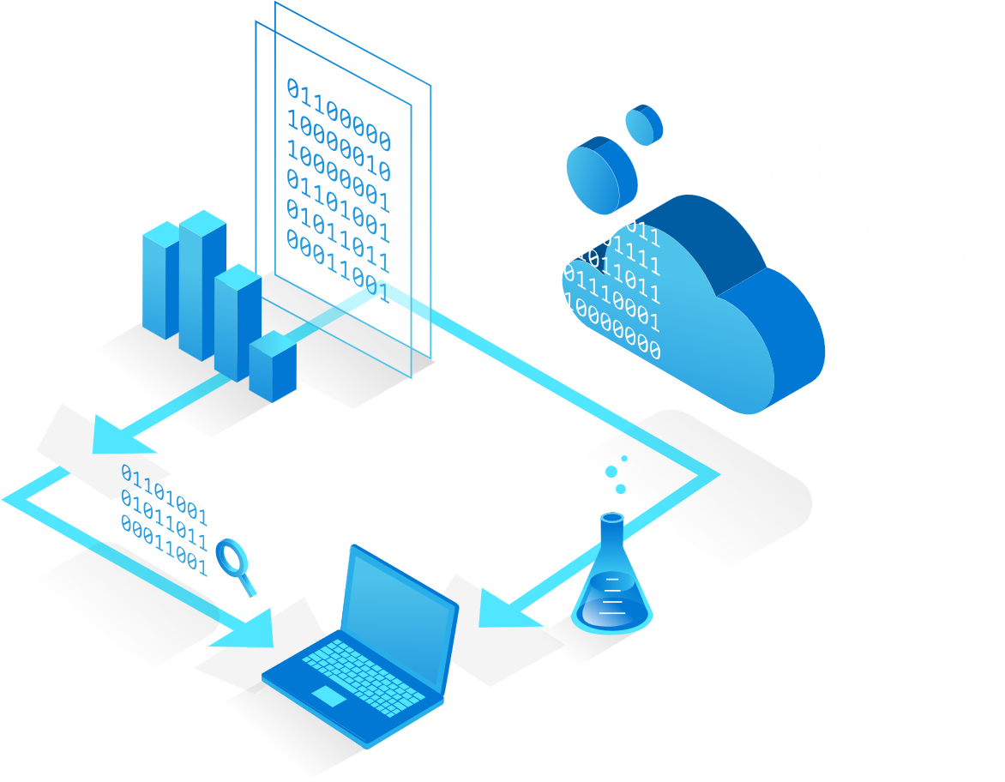

Do more with less on Azure
Migrate and save
Optimize cloud costs
Reinvest to grow
Notes:
There are three core business outcomes when customers want to do more with less: Migrate and save, optimize cloud costs, and reinvest to drive growth

Slide 6
Navigate market uncertainty & accelerate growth with Azure
Migrate
Optimize
Reinvest
Save on costs and gain efficiencies
Rationalize existing cloud investments and improve agility
Become more resilient and drive innovation
Manage escalating energy costs while reducing your energy usage and carbon emissions
Save on IT infrastructure costs and improve operational efficiency, while maintaining agility
Achieve up to 85% savings over standard pay-as-you-go rate when migrating Windows & SQL Server licenses with Azure Hybrid Bo enefit
Save up to 34% in year 1 by adopting Microsoft Cost Management to monitor & reduce spend
Use Azure Advisor to ensure technical workloads are well-architected; reducing costs, increasing security and reliability
Implement Azure Arc to streamline costly 3rd party tools across on-premise, edge, and multi-cloud
Minimize downtime and data loss by securing your hybrid and multi-cloud, focusing on backup and disaster recovery
Invest in app innovation with Azure App Service for 54% TCO savings & Azure AI to drive growth without developer reskilling
Develop innovative, sustainable solutions that create new value while reducing carbon footprint
Notes:
Migrate
Migration is about moving on-premise workloads to Azure to get fundamental cost savings & efficiency gains
There are implicit cost benefits organizations may realize when deferring datacenter management to the cloud provider like energy & IT infrastructure
There are explicit cost benefits to gain with Azure like up to 85% savings when running Windows Server & SQL Server on VMs and leveraging the Azure Hybrid Benefit
Optimize
Optimization is about using tools to reduce existing cloud spend but also ensuring cloud workloads are set up in the right way to optimize cost and performance
Tools like Microsoft Cost Management help forecast, monitor, and identify ways to reduce actual dollars spent and products like Azure advisor provide personalized recommendations to ensure workloads are well-architected
Most organizations have compute surfaces across clouds & on-prem. This is where Azure Arc supports the optimization outcome by bringing a single management pane for all these surfaces
Reinvest
Reinvest is about leveraging the gains from migration & optimization and putting them to critical aspects that will drive a business forward
Key areas for reinvestment include security & business continuity to keep organizations resilient, future proofing applications to capitalize on new customer demands, and leveraging the power of data to find new business value and drive sustainability solutions
CLAIM SUBSTANTIATION
1. Azure Hybrid Benefit disclaimer: https://azure.microsoft.com/en-us/pricing/hybrid-benefit/
2. Azure savings plan disclaimer: https://aka.ms/savingsplan-compute
3. Microsoft Cost Management 34% savings: The Total Economic Impact Of Microsoft Azure Cost Management And Billing, Forrester

Slide 7
Lower costs and increase ROI
MIGRATE AND SAVE
Use your existing investments
Maximize your savings
Increase sustainability
85%
65%
92%
391%
Save up to 85% over pay-as-you-go rates when migrating Windows & SQL Server licenses with Azure Hybrid Benefit
Save up to 65% over pay-as-you-go rates on compute services with Azure savings plan for compute¹
Reduce energy usage up to 92% and carbon emissions up to 98%²
Customers can realize up to 391% ROI on migrating to Azure³
Azure savings plan for compute blog
The Carbon Benefits of Cloud Computing: a Study of the Microsoft Cloud
IDC Business value of migrating and modernizing to Azure commissioned by Microsoft
Notes:
Why does an organization want to migrate – to lower costs and increase ROI
This can manifest by saving on existing investments, leveraging savings plans and offers, and simply getting the sustainability benefits from running in the cloud instead of on-premise
Some Azure only benefits are Azure Hybrid benefit and the recently announced Azure savings plan for compute.
In a recent Business value of migrating and modernizing to Azure study from IDC commissioned by Microsoft, enterprises reported saving on time costs via more efficient Infrastructure staff, as well as a 391 percent ROI over 3 years after moving to Azure

Slide 8
Get more, unparalleled value with Azure
MIGRATE AND SAVE
Best price and performance for SQL and Windows Server; Best TCO for Azure Database for MySQL, Azure Database for PostgreSQL and Azure Arc-enabled Managed Instance
Top performing Azure databases up to 5x faster than AWS¹
Windows Server features only available on Azure – simplify management with Azure Automanage and patch without rebooting using Hotpatch
Reduce hands-on time using systems built with 99.995% SLAs
Best in class free migration tools, programs, and incentives plus architecture delivered as code and training to accelerate time to value
Microsoft Azure SQL Managed Instance (principledtechnologies.com)
Notes:
Azure focuses on delivering the best value at every stage
Azure is particularly competitive in Migration scenarios
Best price & performance for Windows & SQL server + Azure-only features for Windows Server
High up-time SLAs to enable IT & development staff to prioritize high value add activities instead of managing back-end complexities
A collection of tools and programs like the Azure Migration Program to accelerate time to value
CLAIM SUBSTANTIATION
DB performance against AWS: https://www.principledtechnologies.com/Microsoft/Azure-SQL-Managed-Instance-0522.pdf

Slide 9
Save more long-term by investing in Azure
MIGRATE AND SAVE
Migrate CapEx to OpEx to lower financial risk and improve agility for macro-economic conditions
Flexibility to migrate and modernize compute environment while cost optimizing with strategic price offerings
Reduce your carbon footprint with our power-efficient, sustainable datacenters
Notes:
Outside of the initial migration, organizations must position their cloud investments to save long-term, be it the fundamental shift from CapEx to OpEx, selecting a platform with savings mechanisms that are flexible and can grow with you, and/or prioritizing sustainability in the platform selection

Slide 10

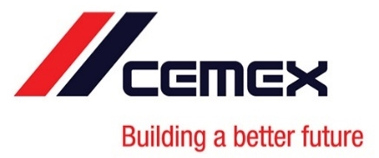
Case Study
Network latency times and procurement delays were negatively impacting employees’ experience and their work
CEMEX knew migration to the cloud could improve customers’ experiences, strengthen existing business, and build a solid foundation for future growth
Along with moving 16 of its SAP systems to Azure, CEMEX migrated non-SAP solutions including Window Server
Migration lead to improved performance between 40-70 % for migrated SAP applications, increased infrastructure flexibility, and added new HA capabilities
CEMEX migrates to Azure for better availability, performance, and lower costs
"In the on-premises environment, we had 1,000 servers, and up to 40 percent weren’t really being used. We were able to decommission a lot of those, which saved us money. Now that we’re in Azure, the servers are optimized to take best advantage of Azure capabilities, which provides additional economic benefits."
Read the full customer story
— Juan Vazquez, IT Architect at CEMEX
Notes:
By migrating its SAP landscape to Microsoft Azure and SUSE Linux Enterprise Server for SAP Applications, CEMEX has saved money, improved performance by 40 to 70 percent for migrated SAP applications, and increased IT flexibility with on-demand cloud services.

Slide 11
Recognize the full value of the cloud
OPTIMIZE CLOUD COSTS
Reliably control spend
Improve workload operational excellence
Increase productivity of hybrid and on-prem workloads
34%
206%
45%
organizations that lift-and-shift to the cloud without cost optimization will overspend by 70% in first 18-months³
Potential year-1 savings from using Microsoft Cost Management¹
Automated recommendations and architecture as code help IT staff prioritize what matters most
Potential 3-year ROI and reduced spend on 3rd party tools used to manage multi-cloud & hybrid environments²
The Total Economic Impact™ of Azure Cost Management and Billing—a commissioned study conducted by Forrester Consulting. Published: February 2021
The Total Economic Impact™ Of Microsoft Azure Arc for Security and Governance – a commissioned study conducted by Forrester Consulting. Published June 2022
Gartner IT Symposium 2020
Notes:
To optimize cloud costs and recognize the full value of the cloud, customers need to optimize their existing investments and can achieve that by:
Controlling cloud spend. Microsoft Cost Management helps customers understand their Azure bill, provides data analysis to their costs, sets spending thresholds, and identifies opportunities for workload changes to optimize their costs.
Improving workload efficiency. Azure Advisor provides personalized best practices for customers to optimize their Azure workloads. Customers can use guidance within the Cloud Adoption Framework and Azure Well-Architected Framework to ensure they follow Microsoft best practices for cost optimization throughout the cloud journey
Making hybrid & multi-cloud environments more productive. Azure Arc helps customers reduce spend on costly 3P tools used to manage hybrid & multi-cloud environments.
CLAIM SUBSTANTIATION (in addition to slide citations)
Microsoft Cost Management 34% savings: https://azure.microsoft.com/en-us/resources/-the-total-economic-impact-of-microsoft-azure-cost-management-and-billing/
TEI of Azure Arc for security & governance – 206% in potential ROI: https://azure.microsoft.com/en-us/resources/forrester-total-economic-impact-of-microsoft-azure-arc-for-security-and-governance/

Slide 12
Do more with less without compromising quality
OPTIMIZE CLOUD COSTS
Reduce operating costs
Visualize, monitor, and forecast cloud spending with Microsoft Cost Management
Azure savings plan for compute – new, flexible pricing model needing less labor to monitor and budget Azure investments
Azure Advisor provides proactive, actionable recommendations to save costs
Eliminate inefficiencies and put data-driven decision making in the hands of the right people with Azure Synapse Analytics
Achieve better quality
World-class best practices and reference architectures to help optimize and deploy workloads
Automated evaluation tools and self-serve assessments for personalized, workload-specific recommendations
Achieve an Azure Advisor score >70 to reduce the odds of application failure
Notes:
Optimizing has two core elements: optimizing costs and optimizing workloads
Optimizing Costs covers products and tools like Microsoft Cost Management and Azure Advisor that give personalized and actionable insights and recommendations on reducing costs, leveraging savings offers to get discounts on select compute services, and reducing the people cost often present in supporting redundant data analysis tasks that could be streamlined with the cloud
Optimizing the workload is all about the way a cloud workload is constructed and ran, often referred to as being well-architected. Azure provides, a deep library of reference material to help customers implement best practices along with self-service & automated tools to get workload-specific recommendations to improve architectures designs.

Slide 13

Bring cloud innovation anywhere with Azure Arc
OPTIMIZE CLOUD COSTS
Save costs on disparate management tools by using a single control pane to secure and govern hybrid and multi-cloud environments
Bring cloud management, app and data services anywhere and extend compute and AI to the edge
Flexibly meet regulatory and connectivity needs with a range of infrastructure options including optimizing your existing hardware
Notes:
Organizations recognize that the public cloud is only one part of the optimization discussion, alongside on-premise, edge & multi-cloud environments
Azure Arc helps bring many of the optimization benefits found in Azure to these other compute services through
A single control pane for workload management
Being able to run Azure management, application, & data services anywhere
Enabling flexibility to meet many regulatory and connectivity needs

Slide 14


Case Study
Pandemic forced difficult decisions to remain financially stable; ASOS identified tech cost optimization strategy to minimize impact
Microsoft consulted with Azure Well-Architected Framework, Azure Cost Management and Billing, Azure Advisor, and more
ASOS benefited from the efficiencies without having to give up much in return
In fact, financial impact was immediate and significant — far bigger than initially predicted (25-40%)
ASOS adapts to business realities with cost optimization
"We achieved a 15 to 20 percent benefit on the annual spend as a result of the housekeeping. No one realized that the fruit of that was that big"
Read the full customer story
— Kristina Moln-Page, Head of Finance at ASOS
Notes:
Like retailers across the globe, ASOS wasn’t immune to the effects of COVID-19. In 2020, as the organization was hit with the financial impacts of the pandemic, it needed to assess where it could optimize its costs. ASOS worked closely with Microsoft to implement the guiding principles of the Azure Well-Architected Framework in order to find ways to reduce and manage costs.

Slide 15
Accelerate growth with your migration and optimization gains
REINVEST TO GROW
Enhance critical security and compliance posture
Prioritize business continuity & disaster recovery
Develop innovative solutions for new business value
$4.3M
$300k
61%
85%
average cost of security breach¹
Average per-hour cost of enterprise downtime²
average revenue increase from data transformations³
of customers will adopt a cloud first approach by 2025
Cost of a data breach report 2022, IBM
The Cost of Enterprise Downtime, Tech Channel
“How to lead a data-driven digital transformation,” Harvard Business Review
Notes:
Why does an organization want to reinvest – to position themselves to accelerate growth on the back of their savings from migration & optimization. This is where ‘doing more’ with less really comes to life.
While simply reserving the savings can be a good strategy, many organizations are realizing the need to better prepare themselves for things like security & down time risks that can cost millions of dollars, starting now to leverage their vast organizational data to uncover new business opportunities, or ensuring their apps are future proof to meet the dynamic needs of their customer & partner ecosystem.
CLAIM SUBSTANTIATION (in addition to slide citations)
85% of customers will adopt a cloud first approach: Top strategic technology trends for 2022: 12 trends shaping the future of digital business, Gartner, 2022

Slide 16
Reduce threats & ensure critical business continuity
REINVEST TO GROW
Reduce downtime with Azure Site Recovery and Azure Backup to avoid up to 93% of unplanned down time vs on-premise¹
Limitless speed and scale Microsoft Sentinel delivers 67% faster deployment 48% cheaper than on-premise SIEMs²
Streamline compliance Over 325 global, regional, and industry regulations and standards, out-of-the-box
Strengthen Data security with dynamic data masking, only available on Azure SQL³
Simplify replication by disaster recovery of on-premises VMware VMs, Hyper-V VMs, or Windows/Linux physical servers to Azure using Azure Site Recovery
Empower developers with embedded security features like Azure web app firewall and get 80% fewer security incidents by integrating security in development⁴
1. Business value of Azure Site Recovery and Azure backup by IDC
2. Total Economic Impact of Microsoft Sentinel study by Forrester Consulting
3. Dynamic data masking only available in Azure SQL. Not SQL in AWS RDS.
4. McKinsey & Company: Driving business outcomes through Developer Velocity 2020
Notes:
Increasing an organization’s security & compliance posture while also ensuring continuity of critical business activities is top of mind for most organizations
This complex space has several elements to consider
Security – prioritizing security across your data & application estate with Microsoft Sentinel’s faster and cheaper deployment than on-premise SIEMs or Azure-only features for data security in Azure SQL
Empowering Developers – one of the best ways to reduce security incidents is giving developers the tools to incorporate security from the ground up. This is why Azure has prioritized embedded security features into key application development tools and released specific services like Azure web app firewall
Down time – be it reducing downtime or simplifying the disaster recovery process with Azure Site Recovery & Azure Backup, avoiding or at least being prepared for unplanned down-time is critical
CLAIM SUBSTANTIATION
Dynamic Data Masking: only available in Azure SQL. Not SQL in AWS RDS. https://azure.microsoft.com/en-us/products/azure-sql/#security

Slide 17
Create new business value
REINVEST TO GROW
Build future-proof apps wherever you are
Accelerate developer velocity up to 46% by building with any Kubernetes, using known tools
Build containerized apps w/Azure Kubernetes Service & deploy consistently, anywhere, with no additional cost​
Utilize built-in maintenance, patching, scaling & over-provisioning protections to focus dev time on high priority initiatives
Unlock the value of your data
Put an end to the integration tax and innovate with confidence
Empower faster decision-making with an integrated data platform, adapting to your needs with AI-driven capabilities
Optimize your data estate with automated insights for data quality, exposure & compliance risks, and productivity opportunities
Record, report, and reduce your environmental impact with Microsoft Sustainability Manager
Notes:
All organizations want to create new value. Most approach this through applications & data, which go hand and hand
Customers need their apps to be future proof
Accelerate their development velocity
Leverage the latest tools wherever they’re needed
Get built-in features to help devs focus on the high-priority activities rather than back-end complexities
Customers have vast amounts of data that can often be put to better use with Azure
Empower faster decision making with an integrated platform rather than stitching together disparate tools
Optimizing the data estate to improve performance insights and security & compliance postures
Using data to advance the organization’s sustainability and environmental missions

Slide 18


Case Study
NBA's direct-to-consumer platform, built on Microsoft Azure, delivers personalized content to fans and generates nearly 10 billion daily interactions
NBA relies on Microsoft Azure to make sense of that sea of numbers using tools such as Azure Data Lake Storage, Azure Machine Learning, Azure Databricks
Azure AI capabilities turn billions of data points into insightful metrics about players and games to power innovative fan experiences and engagement
Turnkey solutions and developer friendly tools enabled the team to fully implement the solution in a matter of weeks
NBA uses Microsoft Azure to power new content that elevates fan engagement
“We’ve always been sitting on a lot of data, but we needed Azure and AI to unlock its potential and find the interesting nuggets in those billions of data points.”
Read the full customer story
— Charlie Rohlf: Associate Vice President, Stats Technology Product Development at the National Basketball Association

Slide 19

Azure solutions to navigate market uncertainty and accelerate growth
Retire technical debt, invest in critical security, & future-proof your apps
Optimize cost savings, improve resilience and architecture
Scale seamlessly to meet demand as needed
Flip CAPEX to OPEX, save vs on-premise
Migrate and save
Optimize cloud costs
Reinvest to grow
Migrate Infrastructure workloads to Azure
Enable Customer Success
Business Continuity & Disaster Recovery
Modernize Enterprise Applications
Microsoft Intelligent Data Platform

Slide 20
Next Steps
Technical Solution Assessment
Assess how your workload can move to Azure and see how much you can save
Azure Migration & Modernization Program
Get technical & partner expertise to accelerate your migration
Azure Advisor
Ensure your architecture is optimized with personalized recommendations
Microsoft Security
Become more resilient and improve your security posture
Take a solution assessment
Nominate a project today
Get your personalized recommendations
Work with your partner to request a security workshop

